Slide 1

Hitchhiker's Guide to Puerto Rico
By Sylvia Y. Perez Montero & Diego Rosa Paz
1.

Slide 2


The Problem
Tourists struggle to find personalized travel recommendations based on their interests.
Notes:
Travelers visiting Puerto Rico often struggle to find personalized, up-to-date recommendations that match their interests. Traditional travel guides and generic search results fail to capture the island’s diverse experiences, from hidden beaches to cultural landmarks. Additionally, weather conditions, accessibility, and real-time factors can impact trip planning. A smart, AI-powered travel planning agent is needed to provide tailored recommendations, ensuring visitors discover the best of Puerto Rico based on their preferences, location, and current conditions.

Slide 3

The Solution
PR Travel Planner App
Develop an AI-powered travel recommendation system that personalizes landmark suggestions based on user inputs.
Travel Dates
Personal Interests
Geographic Areas
Set plans onto a calendar
Email reminders

Slide 4


The Approach
Data Loading
Embedding & Indexing
Flask API
Imports municipality, newspaper and landmark data
Coverts landmarks into searchable AI embeddings
Processes user requests and returns recommendations
Interest-Based Flow
Invalid Request
Type
Helper Functions
Streamlit
Matches landmarks to user interests using AI
Handles errors for unsupported requests
Supports text normalization and weather retrieval.
Testing UI and retrieval

Slide 5
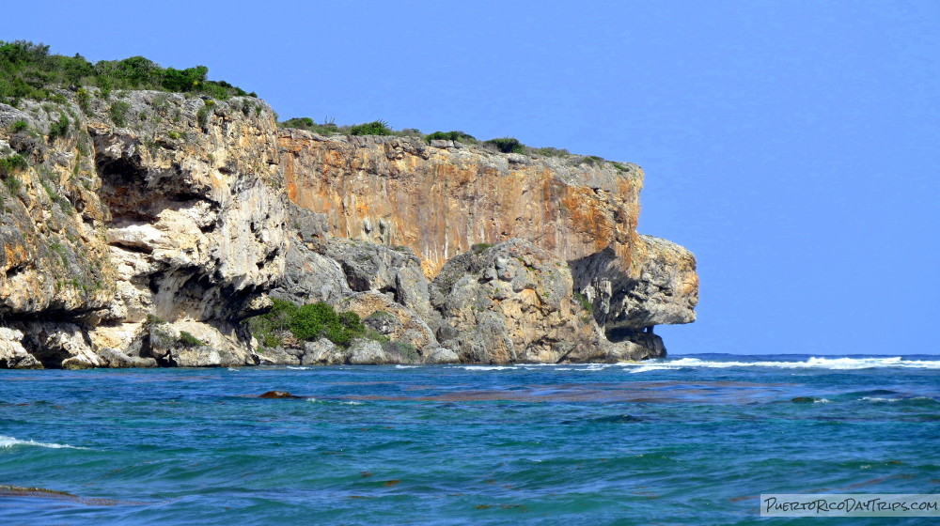
{
"landmarks": [
{
"name":,
"summary":
"latitude":
"longitude":
"embedding": [
],
},
],
"municipalities": [
{
"name":
"summary":
"coordinates": {
"latitude":
"longitude":
},
"image_url":,
"embedding": [
],
},
],
"newspapers": [
{
"date":
"headline":
"content":
"topic": ,
"embedding": [
]
}
]
}
The Data Structure
A lot of our efforts went to cleaning and organizing the data, some persistent issues we found were unicode and encoding errors.

Slide 6
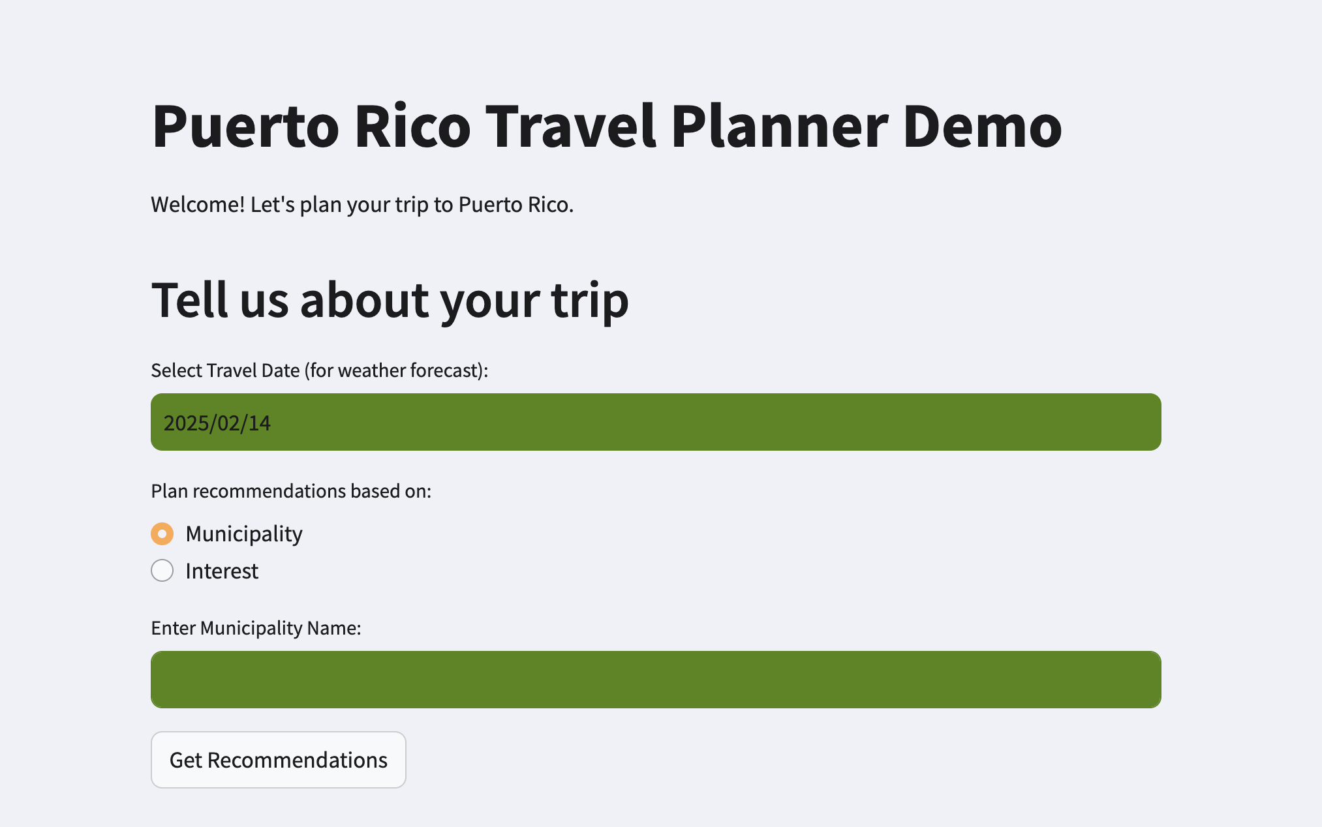
User Interface
Flask + Streamlit
Established a seamless API connection, enabling user-friendly interactions.
Link Flask API to Stream It's34 interface
Provide real-time recommendations
Formatting responses for display
Ensuring smooth data flow between the back-end and the front-end
Notes:
Network connection, network response, handling of places without coordinates

Slide 7
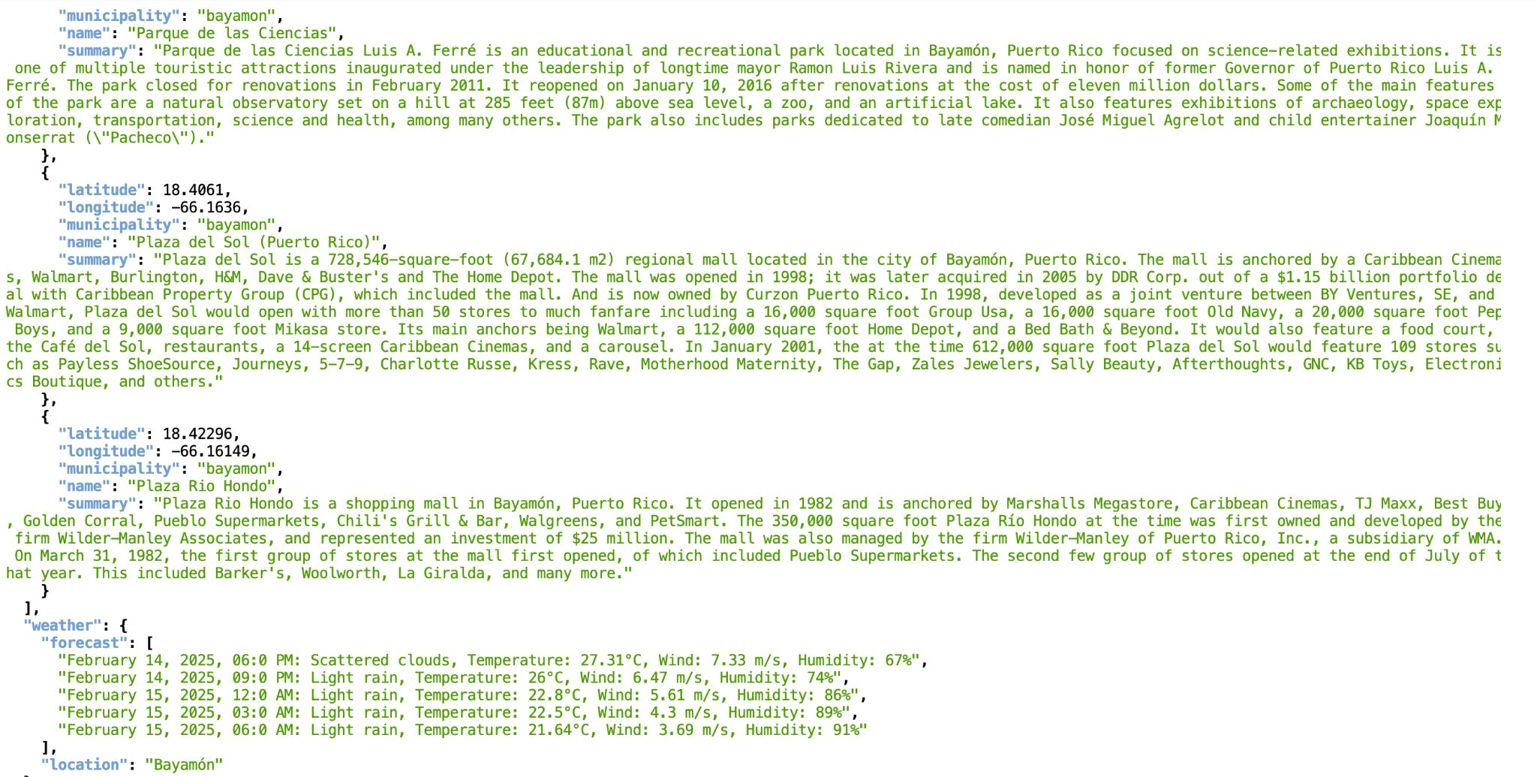
Sample Output
Notes:
Example of Results for Bayamon. Coordinates used to generate municipality, and will also help with map functions in the future.

Slide 8
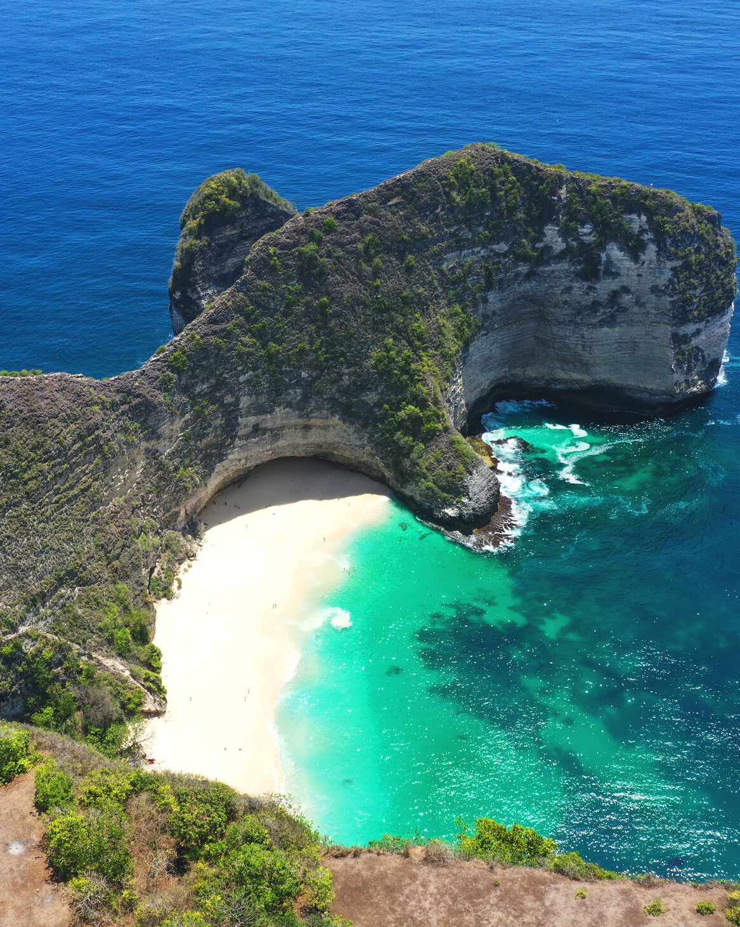

Future Enhancements
User Authentication
Creating an Account
AI-Based Recommendation Enhancements
Booking Integrations
Social Sharing
Translation Capabilities
Map Integration
User Testing
Email and Calendar integration
Notes:
User Authentication: (Google, Apple, or email sign-in)
Create an account: Save trips, preferences
AI-based recommendations: Improve suggestions using machine learning, add recommendations based on travel dates
Booking Integrations: Allow users to book hotels, tours, or restaurants.
Social Sharing: Let users share itineraries with friends.
Translation Capabilities: receive the recommendations in the preferred language.
Map Integration: Uses Google Maps API to display recommended places with pins.
User Testing: qualitative and quantitative research to optimize user experience and agent performance

Slide 9
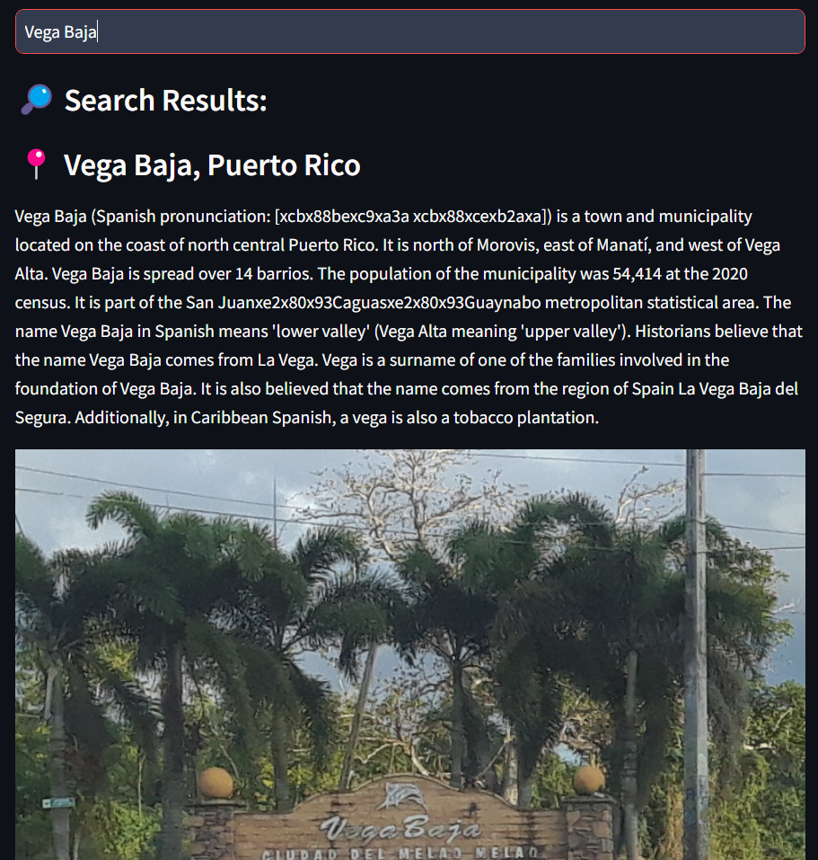
Streamlit implementation
We were able to test the effectiveness of our RAG system and embeddings.
So far it has been able to display images when the URL is present in the dataset.

Slide 10



